Slide 1
Good practices – Gozo
Good Practice Event - Utrecht
eBussed - Building capacities for European-wide e-bus deployment
31st March 2022

Slide 2
Introduction
Drivers & Barriers to e-bus deployment
Cost Benefit Analysis to assess the feasibility of electric buses in the region
Technological requirements & User interface
Logbook in e-bus for monitoring of trip and driver feedback
Pre-testing of e-bus as training for drivers and technical staff prior to the launch of e-bus pilot project
Procurement and tendering
Pilot project with an electric bus prior to the procurement of a large fleet of e-buses
Notes:
The process of changing the whole bus fleet from diesel to electric involves a lot of planning.
The transition from diesel to electric can be driven by a national legalization or by a policy that drives the transport operator to shift to cleaner vehicles.
Since the electrification is something new for the local context, there are a lot of things that are still unclear. The shift to electric buses involves a lot of changes in the current operation system, in the maintenance system and in the infrastructure.
This transition involves constant communication with local institutions mainly with Transport Malta (transport authority) and Enemalta (the electricity provider).

Slide 3
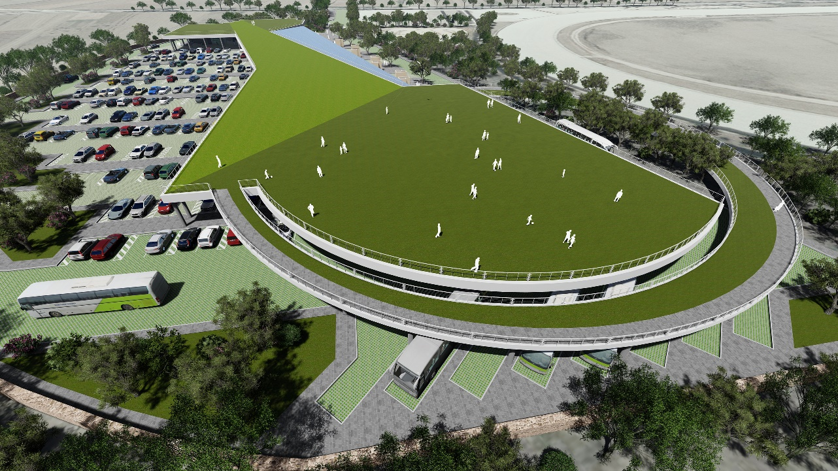
1- Cost Benefit Analysis to assess the feasibility of electric buses in the region
Short description: Prior to the purchase of electric buses in Gozo, a cost benefit analysis was done to assess the demand for a park and ride system in Gozo and also the feasibility of using electric buses for this system.

Slide 4
1- Cost Benefit Analysis to assess the feasibility of electric buses in the region
Objectives:
To assess the feasibility of using e-buses for a park and ride service in Gozo;
To get feedback from stakeholders about the introduction of such a system;
To find out the benefits that can arise from using such a system.
Added value: The value of this practice is that it enables the territory to have an analysis of the costs and benefits of introducing electric buses in their region prior to doing the actual investment in the project.
Transferability: This good practice may be useful for territories which like Malta do not yet have an electric bus fleet since it is a practice which helps to make the territory more aware of the costs and benefits associated with such a project.

Slide 5
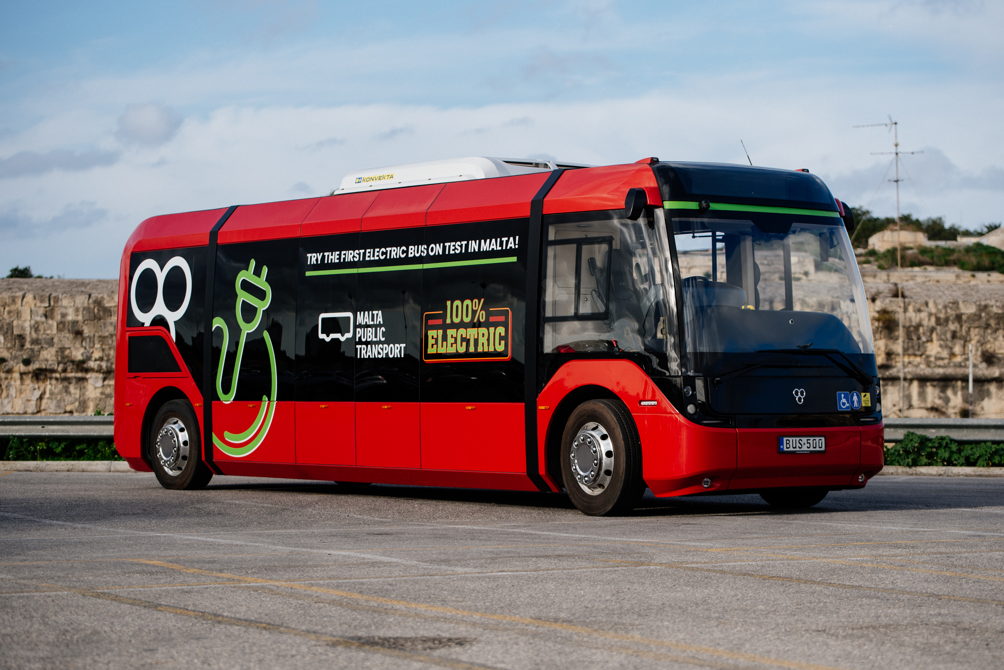
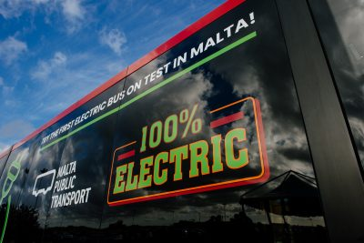
TAM Electric bus pilot in Malta
Notes:
This was the first electric bus in Malta, this ebus was tested between 20th January 2020 and 23rd July 2020.
Initially, the ebus was tested on some uphill roads before operating on three routes with different elevations. From this pilot 3 good practices were identified

Slide 6
2- Logbook in e-bus for monitoring of trip and driver feedback
During the TAM electric bus pilot project in Malta a logbook was kept in the bus to monitor the distance travelled, the operation time and consumption. This logbook was also used by the drivers to write their feedback about the issues encountered during testing.

Slide 7
2- Logbook in e-bus for monitoring of trip and driver feedback
Objectives:
To keep record of the trips' information (timings, consumption);
To eventually compare the performance of the electric bus on different routes and during different times of the day;
To get any driver feedback which can be relevant for the future tests;
Benefits:
Having a logbook in which possible issues and experiences encountered during testing are listed may help in preventing some of these problems from being replicated in the future tests.
Notes:
The data collected from this logbook during the pilot project was very useful for MPT to take informed decisions for the future electrification of the public transport fleet.

Slide 8
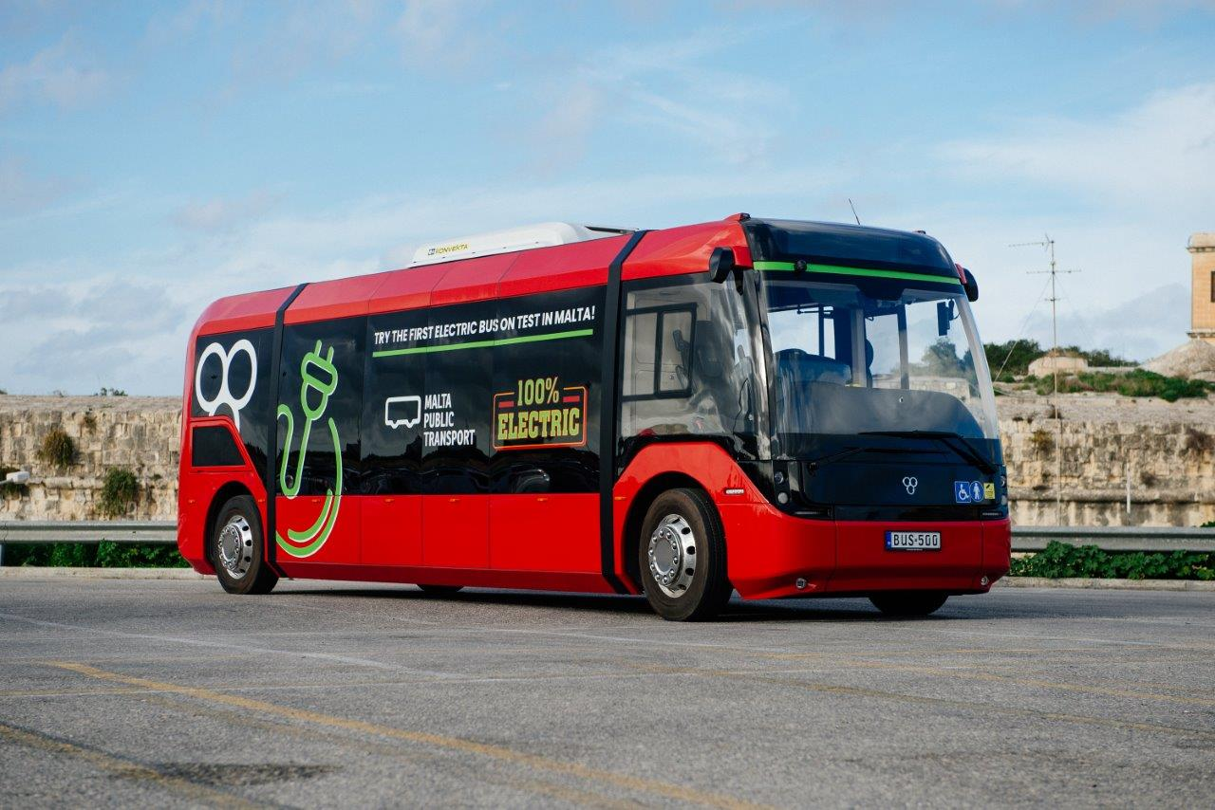
3. Pre-testing of e-bus as training for drivers and technical staff prior to the launch of e-bus pilot project
It also helped to test some roads with a challenging topography (uphills with frequent stops).
This allowed identification of the performance limits of the bus prior to the actual pilot phase.
Objectives:
To monitor the performance of the e-bus in challenging roads before assigning the routes that the electric bus will operate on during the pilot phase;
To enable the technical staff to identify any common issues encountered during the pre-testing phase;
To serve as training for the drivers and technical staff;
To avoid passenger discomfort/complaints if the e-bus does not manage to perform well in a certain road, hence not assigned as a route during piloting.
Notes:
Pre-testing of the bus in certain roads served as training for drivers and technical staff that worked on the electric bus.
The pre-testing helped to identify the main challenges of the bus operating in the local context before proceeding with the actual pilot project and to address them where possible.
Served as training phase to drivers and technical staff to learn from the issues encountered; this makes this good practice useful when transferred to territories which are planning to start operating e-buses.

Slide 9
Pilot project
Gain knowledge
Future procurement
Upscaling
Identify challenges
Analysis of Technical specifications
Notes:
In Malta, a pilot project was done to test an electric bus in the specific local context before the procurement of a large fleet of e-buses.
This helped the transport operator to gain knowledge and identify the challenges of an electric bus operating on the Maltese roads. (charactherised by their hilly terrain, high temperatures and frequent stopping due to traffic);
We learned that for future procurement, the technical specifications of the bus must be analysed and adapted to the local context. Eventually, after testing a few pilot projects we are aiming to upscale to a larger number of ebuses.
This good practice can be relevant to those countries that still have not operated an electric bus. A pilot project would help to identify the local challenges and to analyse the technical specifications of the electric bus before the actual procurement of a larger fleet. Furthermore, the experiences learned from this pilot may be useful to other territories since it may help to identify some common issues which can be avoided during the procurement stage.

Slide 10
Q & A
Kimberlin Bartolo
Malta Public Transport

