Slide 1
Smart charging projects at Qbuzz
EBUSSED – 30/03/2022 – Sanne Gort
Notes:
Introductie slimladen; wat is het, wat kun je er mee, hoe werkt het, waarom, wat kunnen we er mee bereiken (maatschappelijk, overbelasting etc.)
Deelnemen aan IRIS + stappen die we gezet hebben binnen IRIS (introductie IRIS)
Plaatjes

Slide 2
Content
Introduction to smart charging
Participation in IRIS project
Qbuzz timeline
Past years
Current situation
Future
Recap

Slide 3
Introduction to smart charging
Smart charging: Not an widely accepted definition yet
In the context of Qbuzz: A charging system in which we control the charging pattern of the electric bus at the depots
Power and timing
Total charged remains the same
Why smart charging?
Control the peak power
Less impact on the grid
Enables a smaller connection to the grid
Reduced electricity costs
Control timing of consumption
Reduced electricity costs
Notes:
Nog niet eenduidig, onze definitie. >> verschillende mogelijkheden
Batterij minder belasten >> lagere vermogens

Slide 4
Participation in the IRIS project
Horizon 2020 EU funded project
Duration: 5 years (2017-2022)
Participants: i.a. Utrecht University, Municipality of Utrecht, Qbuzz
Aim: Accelerate the adoption of energy, mobility and ICT initiatives
Our contribution: Sharing data for analysis, research etc.

Slide 5
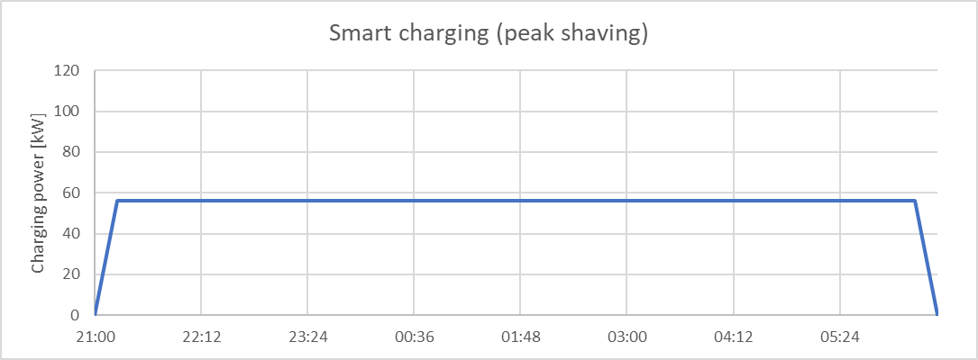
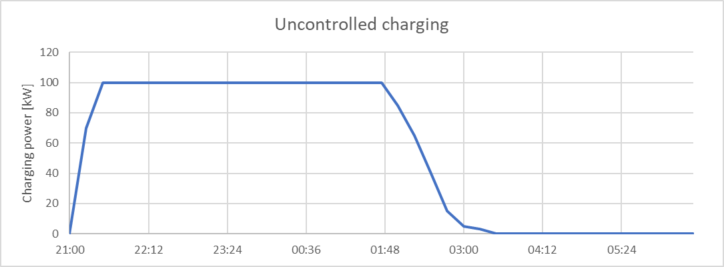
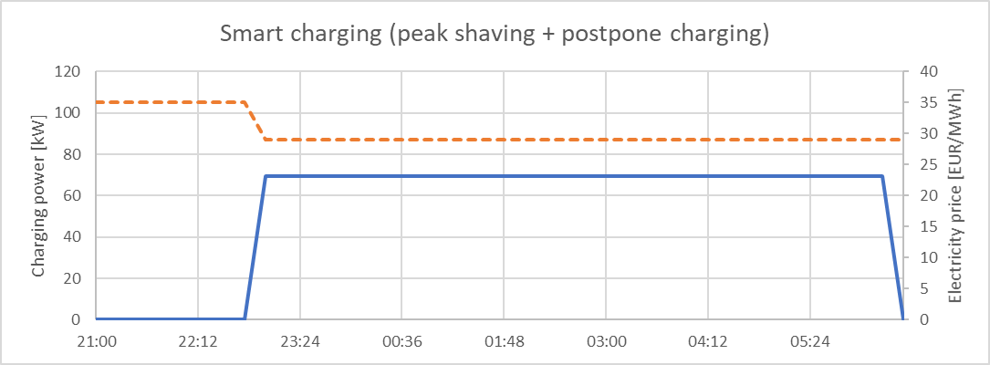
Introduction to smart charging
Notes:
Controlled charging > definities geven van strategie
Vertellen adhv een praktijkvoorbeeld

Slide 6
Timeline
Research on smart charging
Preparations for smart charging and implementation
2019
2021
Notes:
Dit doen we binnen qbuzz

Slide 7
Past years
Research on smart charging
Preparations for smart charging and implementation
2019
2020
Thesis Marle Zijlstra (Energy Science, UU)
Aim:
Compare the saving potential of 5 different smart charging strategies
Peak shaving
Day ahead market (DAM) trading
DAM trading + vehicle-2-grid
DAM trading + FCR (imbalance market)
DAM trading + aFRR (imbalance market)
Concluded most potential for:
Peak shaving: electricity cost reduction 16-21%
DAM trading: electricity cost reduction 43-48%
Limitation:
DAM prices as well as electricity consumption were assumed to be given

Slide 8
DAM
Research on smart charging
Preparations for smart charging and implementation
2019
2020
Hourly electricity prices and bigger price fluctuations
Supply and demand based
Higher saving potential

Slide 9
Past years
Research on smart charging
Preparations for smart charging and implementation
2019
2020
Thesis Marle Zijlstra (Energy Science, UU)
Aim:
Compare the saving potential of 5 different smart charging strategies
Peak shaving
Day ahead market (DAM) trading
DAM trading + vehicle-2-grid
DAM trading + FCR (imbalance market)
DAM trading + aFRR (imbalance market)
Concluded most potential for:
Peak shaving: electricity cost reduction 16-21%
DAM trading: electricity cost reduction 43-48%
Limitation:
DAM prices as well as electricity consumption were assumed to be given

Slide 10
Past years
Research on smart charging
Preparations for smart charging and implementation
2019
2021
Follow-up thesis
Aim:
Compare the saving potential of 3 different smart charging strategies
Peak shaving
Peak shaving + postpone charging (fixed electricity price based)
DAM trading
Based on unknown DAM prices and electricity consumption
Conclusion:
Peak shaving: electricity cost reduction 7-15%
Peak shaving + postpone charging: electricity cost reduction 10-16%
DAM trading: electricity cost reduction 7-53%

Slide 11
Timeline and charging strategies
Research on smart charging
Preparations for smart charging and implementation
Naïve charging
Phase 1: peak shaving + shifting electricity consumption
Phase 2: Purchase electricity on other energy markets
Phase 3: Bi-directional charging
2019
2021
Notes:
Dit doen we binnen qbuzz

Slide 12
Current situation
Research on smart charging
Preparations for smart charging and implementation
Naïve charging
Phase 1: peak shaving + shifting electricity consumption
Phase 2: Purchase electricity on other energy markets
Phase 3: Bi-directional charging
2019
2021
Now
Preparation phase 1
Testing hardware (chargers, buses) and software (ViriCiti)
Determine limits using an optimization model
Principle: all buses should be able to charge to 100% if they arrive with a SoC of 20%
First six depots in the coming weeks
Notes:
Dit doen we binnen qbuzz

Slide 13
Smart charging – example
Depot Zoutkamp
Step 1: Peak shaving
Step 2: Peak shaving + postponing charging

Slide 14
Future - phase 2
Research on smart charging
Preparations for smart charging and implementation
Naïve charging
Phase 1: peak shaving + shifting electricity consumption
Phase 2: Purchase electricity on other energy markets
Phase 3: Bi-directional charging
2019
2021
At the same time: Preparation phase 2
Which energy markets are interesting for Qbuzz?
What does trading at those energy markets involve?
E.g. Hardware, software, third parties
Is the businesscase profitable?
Notes:
Dit doen we binnen qbuzz

Slide 15
Future - phase 3
Research on smart charging
Preparations for smart charging and implementation
Naïve charging
Phase 1: peak shaving + shifting electricity consumption
Phase 2: Purchase electricity on other energy markets
Phase 3: Bi-directional charging
2019
2021
At the same time: Preparation phase 3
Pilot with refurbished 90 kWh bus battery
Aim: Explore potential for electricity costs reduction with bigger battery packages & practical experience
Appraoch:
Exploration possible strategies and requirements
Explore businesscases >> GO/NO GO
If GO: Start pilot
Notes:
Dit doen we binnen qbuzz

Slide 16
Recap
Smart charging: “A charging system in which we control the charging pattern of the electric bus at the depots”
Research has been conducted
Timeline has been set up
Phase 1: Peak shaving and peak shaving + postpone charging
Fixed electricity price based
Phase 2: Purchase electricity on other energy markets
Phase 3: Bi-directional charging
Lower our electricity costs
Notes:
Dit doen we binnen qbuzz

Slide 17
Thank you for your attention

Slide 18
Programme today
11:05 | 12:05 | Parallel session 1 (Chair: Rien van Stigt) ZOCHER Experiences of ebusses by Keolis Gretha van Velthuizen (Keolis) Charging infra and spatial planning Aart Reurink (Province of Utrecht)
11:05 | 12:05 | Parallel session 2 (Chair: Pascal Ravesteijn) CHAPEL Qdrive programme (Online) Martin Vis (Qbuzz) Monitoring of Zero Emission Busses Martijn Rotteveel (CROW)

